Slide 1
Main classes:

Slide 2
Main classes:
1. pyDatabases
Contains relevant classes:
GpyDB
gpy
adjMultiIndexDB/ adjMultiIndex
OrdSet
gpyDB_wheels.adj
gpyDB_wheels.read
gpyDB_wheels.robust
gpyDB_wheels.aggregateDB
2. GmsWrite
Contains methods:
_GmsWrite:
writeGpy
writeRoot
writeFunctions
writeDeclare
writeModel
writeSolve
standardArgs
standardRun
3. GmsPy
Contains classes:
Group
Compile
GmsSettings
GmsModel
and methods:
mergeGmsSettings
mergeStates

Slide 3
4. CGE_GmsPython
Contains relevant classes:
GmsPython
Submodule
Production(GmsPython) (from CGE_Production.py)
Aux. classes
Classes used for CGE_GmsPython
nestingTree.py
GamsProduction.py
CGE_globals.py

Slide 4
Dependency Graph:
pyDatabases
GamsProduction
_GmsWrite
GmsWrite
nestingTree
GmsPython
Compile
GmsModel
Group
GmsSettings
GmsPy

Slide 5
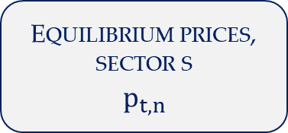
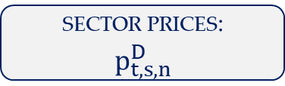
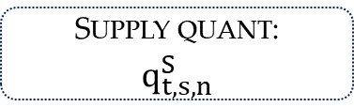
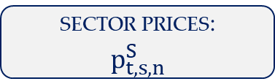
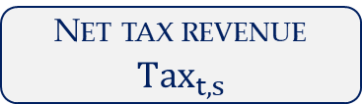
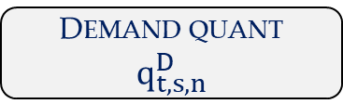
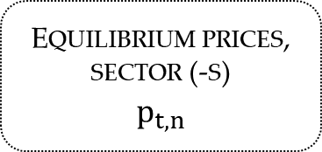
Modular Structure: CRS supply
Equilibrium prices, sector s
$$p_{t,n}$$
Equilibrium prices, sector (-s)
$$p_{t,n}$$
regulation
regulation
sector prices:
$$p_{t,s,n}^{D}$$
regulation
sector prices:
$$p_{t,s,n}^{S}$$
Demand quant
$$q_{t,s,n}^{D}$$
Optimization
Supply quant:
$$q_{t,s,n}^{S}$$
Net tax revenue
$$Tax_{t,s}$$

Slide 6
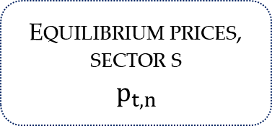
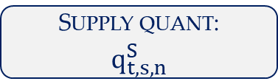
Modular Structure: DRS supply
Equilibrium prices, sector s
$$p_{t,n}$$
Equilibrium prices, sector (-s)
$$p_{t,n}$$
regulation
regulation
sector prices:
$$p_{t,s,n}^{D}$$
regulation
sector prices:
$$p_{t,s,n}^{S}$$
Demand quant
$$q_{t,s,n}^{D}$$
Optimization
Supply quant:
$$q_{t,s,n}^{S}$$
Net tax revenue
$$Tax_{t,s}$$

